Slide 1
CSE 2202 Design and Analysis of Algorithms – I Single Source Shortest Path (Dijkstra and Bellman Ford)

Slide 2
Single Source Shortest Path(Dijkstra’s Algorithm)

Slide 3
Shortest Path Problems
What is shortest path ?
shortest length between two vertices for an unweighted graph:
smallest cost between two vertices for a weighted graph:
B
B
210
A
A
450
60
190
C
unweighted graph
C
weighted graph
200
130
D
D
E
E

Slide 4
Shortest Path Problems
How can we find the shortest route between two points on a map?
Model the problem as a graph problem:
Road map is a weighted graph:
vertices = cities
edges = road segments between cities
edge weights = road distances
Goal: find a shortest path between two vertices (cities)

Slide 5
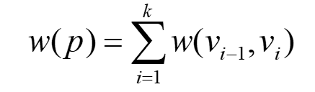
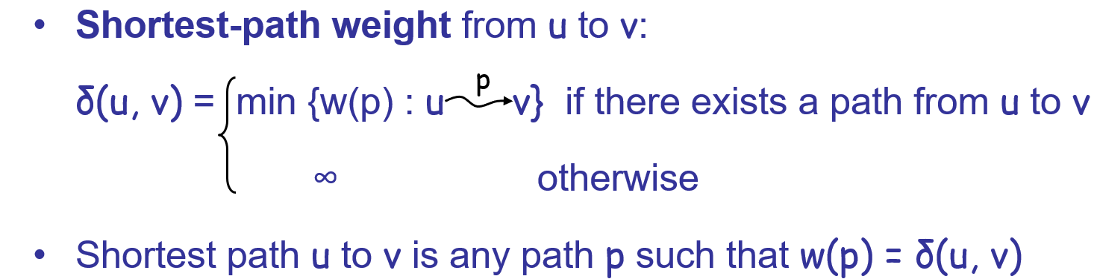
Shortest Path Problems
Input:
Directed graph G = (V, E)
Weight function w : E → R
Weight of path p = ⟨v₀, v₁, . . . , v_{k}⟩
t
x
3
6
9
3
4
s
0
2
1
2
7
5
3
5
11
6
y
z

Slide 6
Variants of Shortest Paths
Single-source shortest path
G = (V, E) ⇒ find a shortest path from a given source vertex s to each vertex v ∈ V
Single-destination shortest path
Find a shortest path to a given destination vertex t from each vertex v
Reverse the direction of each edge ⇒ single-source
Single-pair shortest path
Find a shortest path from u to v for given vertices u and v
Solve the single-source problem
All-pairs shortest-paths
Find a shortest path from u to v for every pair of vertices u and v

Slide 7
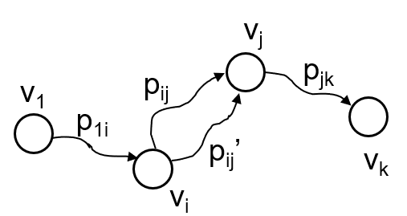
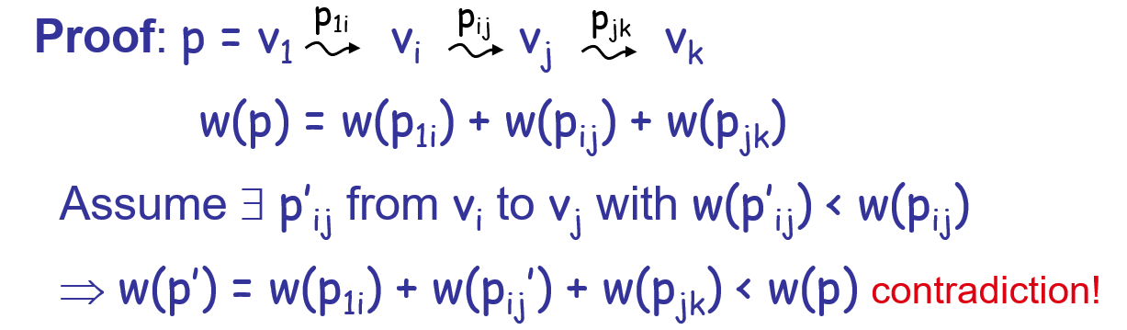
Optimal Substructure of Shortest Paths
Given:
A weighted, directed graph G = (V, E)
A weight function w: E → R,
A shortest path p = ⟨v₁, v₂, . . . , v_{k}⟩ from
v₁ to v_{k}
A subpath of p: p_{ij} = ⟨v_{i}, v_{i+1}, . . . , v_{j}⟩, with 1 ≤ i ≤ j ≤ k
Then: p_{ij} is a shortest path from v_{i} to v_{j}

Slide 8
Shortest-Path Representation
For each vertex v ∈ V:
v.d = δ(s, v): a shortest-path estimate
Initially, d[v]=∞
Reduces as algorithms progress
v.π = predecessor of v on a shortest path from s
If no predecessor, v.π = NIL
π induces a tree—shortest-path tree
Shortest paths & shortest path trees are not unique
t
x
3
6
9
3
4
s
0
2
1
2
7
5
3
5
11
6
y
z

Slide 9
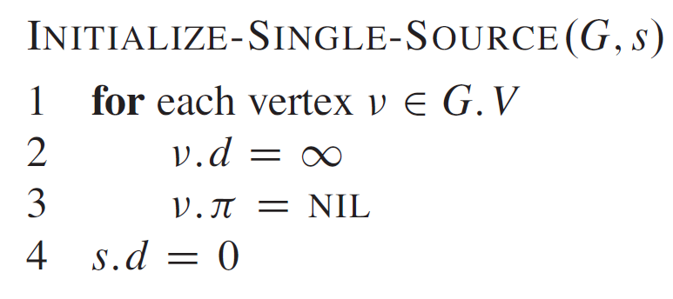
Initialization
All the shortest-paths algorithms start with INITIALIZE-SINGLE-SOURCE

Slide 10
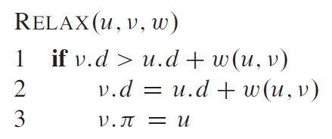
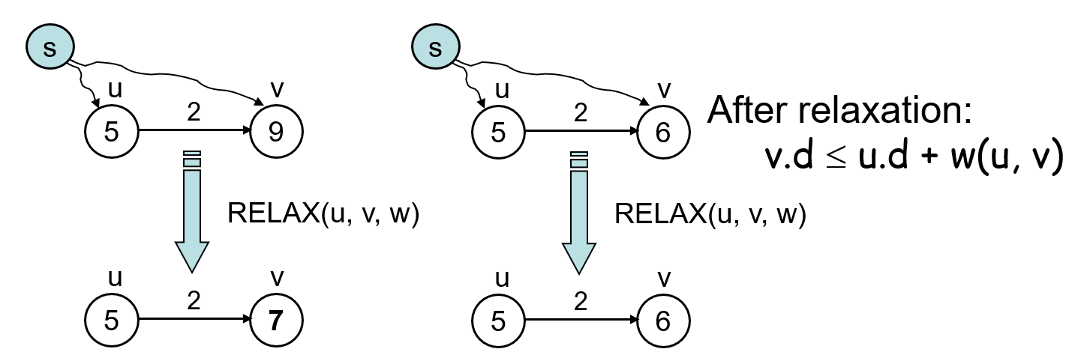
Relaxation
Relaxing an edge (u, v) = testing whether we can improve the shortest path to v found so far by going through u

Slide 11
RELAX(u, v, w)
All the single-source shortest-paths algorithms
start by calling INIT-SINGLE-SOURCE
then relax edges
The algorithms differ in the order and how many times they relax each edge

Slide 12
Dijkstra’s Algorithm
Single-source shortest path problem:
No negative-weight edges: w(u, v) > 0 ∀ (u, v) ∈ E
Maintains two sets of vertices:
S = vertices whose final shortest-path weights have already been determined
Q = vertices in V – S: min-priority queue
Keys in Q are estimates of shortest-path weights (v.d)
Repeatedly select a vertex u ∈ V – S, with the minimum shortest-path estimate v.d

Slide 13
Dijkstra (G, w, s)
t
1
x
INITIALIZE-SINGLE-SOURCE(V, s)
S ← ∅
Q ← G. V
while Q ≠ ∅
do u ← EXTRACT-MIN(Q)
S ← S ∪ {u}
for each vertex v ∈ G.Adj[u]
do RELAX(u, v, w)
∞
∞
10
9
s
0
2
3
4
6
5
7
∞
∞
2
y
z
t
1
x
∞
∞
10
10
9
s
0
2
3
4
6
5
7
∞
∞
5
2
y
z

Slide 14
Example
t
1
x
t
1
x
10
∞
8
14
8
14
13
10
9
10
9
s
0
2
3
4
6
s
0
2
3
4
6
5
7
5
7
5
∞
5
7
7
2
2
y
z
y
z
t
x
t
1
x
1
8
9
8
13
9
10
9
10
9
2
3
4
6
s
0
2
3
4
6
s
0
5
7
5
7
5
7
5
7
2
2
y
z
y
z

Slide 15
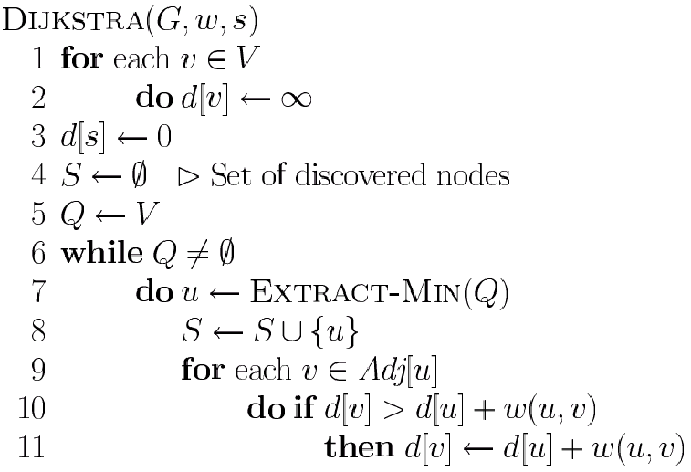
Dijkstra’s Pseudo Code
Graph G, weight function w, root s
relaxing edges

Slide 16
Dijkstra (G, w, s)
INITIALIZE-SINGLE-SOURCE(G, s)
S ← ∅
Q ← G.V
while Q ≠ ∅
do u ← EXTRACT-MIN(Q)
S ← S ∪ {u}
for each vertex v ∈ G.Adj[u]
do RELAX(u, v, w)
Running time: O(VlgV + ElgV) = O(ElgV)
Θ(V)
O(V) build min-heap
Executed O(V) times
O(lgV)
O(E) times; O(lgV)

Slide 17
Dijkstra’s Running Time
Extract-Min executed |V| time
Decrease-Key executed |E| time
Time = |V| T_{Extract-Min} + |E| T_{Decrease-Key}
T depends on different Q implementations
Q | T(Extract-Min) | T(Decrease-Key) | Total
array | Ο(V) | Ο(1) | Ο(V ²)
binary heap | Ο(lg V) | Ο(lg V) | Ο(E lg V)
Fibonacci heap | Ο(lg V) | Ο(1) (amort.) | Ο(V lgV + E)

Slide 18
Question
Prove that, if there exists negative edge, dijkstra’s shortest path algorithm may fail to find the shortest path
Print the shortest path for dijkstra’s algorithm
Suppose you are given a graph where each edge represents the path cost and each vertex has also a cost which represents that, if you select a path using this node, the cost will be added with the path cost. How can it be solved using Dijkstra’s algorithm?

Slide 19
Negative-Weight Edges
s → a: only one path
δ(s, a) = w(s, a) = 3
s → b: only one path
δ(s, b) = w(s, a) + w(a, b) = -1
s → c: infinitely many paths
⟨s, c⟩, ⟨s, c, d, c⟩, ⟨s, c, d, c, d, c⟩
cycle has positive weight (6 - 3 = 3)
⟨s, c⟩ is shortest path with weight δ(s, c) = w(s, c) = 5
What if we have negative-weight edges?
a
b
3
-4
-1
3
4
c
6
d
g
s
0
5
5
11
8
-∞
-3
2
3
7
-∞
-∞
e
-6
f

Slide 20
Negative-Weight Edges
s → e: infinitely many paths:
⟨s, e⟩, ⟨s, e, f, e⟩, ⟨s, e, f, e, f, e⟩
cycle ⟨e, f, e⟩ has negative weight:
3 + (- 6) = -3
can find paths from s to e with arbitrarily large negative weights
δ(s, e) = - ∞ ⇒ no shortest path exists between s and e
Similarly: δ(s, f) = - ∞, δ(s, g) = - ∞
a
b
3
-4
-1
3
4
c
6
d
g
s
0
5
5
11
8
-∞
-3
2
3
7
-∞
-∞
e
-6
f
h
i
∞
2
∞
h, i, j not
reachable
from s
-8
3
∞
j
δ(s, h) = δ(s, i) = δ(s, j) = ∞

Slide 21
Negative-Weight Edges
Negative-weight edges may form negative-weight cycles
If such cycles are reachable from
the source: δ(s, v) is not properly
defined
Keep going around the cycle, and get
w(s, v) = - ∞ for all v on the cycle
a
b
-4
3
4
c
6
d
g
s
0
5
8
-3
2
3
7
e
-6
f

Slide 22
Cycles
Can shortest paths contain cycles?
Negative-weight cycles
Positive-weight cycles:
By removing the cycle we can get a shorter path
We will assume that when we are finding shortest paths, the paths will have no cycles
No!
No!

Slide 23
Bellman ford

Slide 24
Bellman-Ford Algorithm
Single-source shortest paths problem
Computes v.d and v.π for all v ∈ V
Allows negative edge weights
Returns:
TRUE if no negative-weight cycles are reachable from the source s
FALSE otherwise ⇒ no solution exists
Idea:
Traverse all the edges |V – 1| times, every time performing a relaxation step of each edge
This is because, in the worst-case scenario, any vertex's path length can be changed N times to an even shorter path length.

Slide 25
BELLMAN-FORD(V, E, w, s)
INITIALIZE-SINGLE-SOURCE(V, s)
for i ← 1 to |V| - 1
do for each edge (u, v) ∈ E
do RELAX(u, v, w)
for each edge (u, v) ∈ E
do if d[v] > d[u] + w(u, v)
then return FALSE
return TRUE
t
5
x
∞
∞
6
-2
-3
s
0
8
7
-4
7
2
∞
∞
9
y
z
t
5
x
∞
∞
6
6
-2
-3
s
0
8
7
-4
7
2
∞
∞
E: (t, x), (t, y), (t, z), (x, t), (y, x), (y, z), (z, x), (z, s), (s, t), (s, y)
7
9
y
z

Slide 26
Example
(t, x), (t, y), (t, z), (x, t), (y, x), (y, z), (z, x), (z, s), (s, t), (s, y)
t
5
x
t
x
Pass 1
Pass 2
5
6
∞
6
∞
4
11
6
-2
6
-2
-3
-3
s
0
8
7
8
7
s
0
-4
-4
7
2
7
2
7
∞
7
∞
9
2
y
z
9
y
z
Pass 3
t
5
x
Pass 4
t
5
x
6
∞
6
∞
2
4
11
2
4
11
6
-2
6
-2
-3
-3
s
0
8
7
0
8
7
s
-4
-4
7
2
7
2
7
∞
7
∞
2
2
9
9
-2
y
z
y
z

Slide 27
Detecting Negative Cycles
for each edge (u, v) ∈ E
do if v.d > u.d + w(u, v)
then return FALSE
return TRUE
s
b
0
2
∞
-8
3
∞
c
s
b
s
b
Look at edge (s, b):
b.d = -1
s.d + w(s, b) = -4
⇒ b.d > s.d + w(s, b)
0
2
∞
-3
2
2
-3
2
-6
-1
-8
3
-8
3
∞
5
5
2
c
c

Slide 28
BELLMAN-FORD(V, E, w, s)
INITIALIZE-SINGLE-SOURCE(V, s)
for i ← 1 to |G.V| - 1
do for each edge (u, v) ∈ G.E
do RELAX(u, v, w)
for each edge (u, v) ∈ G.E
do if v.d > u.d + w(u, v)
then return FALSE
return TRUE
Running time: O(VE)
Θ(V)
O(V)
O(E)
O(VE)
O(E)

Slide 29
Shortest Path Properties
Triangle inequality
For all (u, v) ∈ E, we have:
δ(s, v) ≤ δ(s, u) + w(u, v)
If u is on the shortest path to v we have the equality sign
s
u
v
5
2
7
s
u
v
5
2
6

Slide 30
Shortest Path Properties
Upper-bound property
We always have v.d ≥ δ(s, v) for all v.
Once v.d = δ(s, v), it never changes.
The estimate never goes up – relaxation only lowers the estimate
v
5
x
v
5
x
6
∞
6
∞
4
2
4
11
11
6
-2
Relax (x, v)
6
-2
-3
-3
s
0
8
7
s
0
8
7
-4
-4
7
2
7
2
7
∞
7
∞
2
2
9
9
y
z
y
z

Slide 31
Shortest Path Properties
No-path property
If there is no path from s to v then v.d = ∞ always.
δ(s, h) = ∞ and h.d ≥ δ(s, h) ⇒ h.d = ∞
a
b
-4
h
i
3
-1
2
4
∞
∞
3
c
d
g
6
h, i, j not
reachable
from s
s
0
5
5
11
8
-∞
-8
3
y
-3
∞
2
3
7
-∞
-∞
j
e
-6
f
δ(s, h) = δ(s, i) = δ(s, j) = ∞

Slide 32
Shortest Path Properties
Convergence property
If s u → v is a shortest path, and if u.d = δ(s, u) at any time prior to relaxing edge (u, v), then v.d = δ(s, v) at all times afterward.
u
v
If v.d > δ(s, v) ⇒ after relaxation:
v.d = u.d + w(u, v)
v.d = 5 + 2 = 7
Otherwise, the value remains unchanged, because it must have been the shortest path value
2
6
∞
5
8
11
5
s
0
4
4
7

Slide 33
Shortest Path Properties
Path relaxation property
Let p = ⟨v₀, v₁, . . . , v_{k}⟩ be a shortest path from s = v₀ to v_{k}. If we relax, in order, (v₀, v₁), (v₁, v₂), . . . , (v_{k-1}, v_{k}), even intermixed with other relaxations, then d[v_{k} ] = δ(s, v_{k}).
v₁
2
v₂
d[v₂] = δ(s, v₂)
6
∞
v₄
∞
∞
11
5
7
∞
5
3
14
d[v₁] = δ(s, v₁)
4
v₃
s
0
∞
d[v₄] = δ(s, v₄)
11
d[v₃] = δ(s, v₃)

Slide 34
Single-Source Shortest Paths in DAGs

Slide 35

Single-Source Shortest Paths in DAGs
Given a weighted DAG: G = (V, E) – solve the shortest path problem
Idea:
Topologically sort the vertices of the graph
Relax the edges according to the order given by the topological sort
for each vertex, we relax each edge that starts from that vertex
Are shortest-paths well defined in a DAG?
Yes, (negative-weight) cycles cannot exist
u
2
v
6
∞
11
5
y
4
4
x
In such setting, we can compute shortest paths from a single source in time:

Slide 36
DAG-SHORTEST-PATHS(G, w, s)
topologically sort the vertices of G
INITIALIZE-SINGLE-SOURCE(V, s)
for each vertex u, taken in topologically sorted order
do for each vertex v ∈ G.Adj[u]
do RELAX(u, v, w)
Running time: Θ(V+E)
Θ(V+E)
Θ(V)
Θ(V)
Θ(E)
We have used an aggregate analysis here

Slide 37
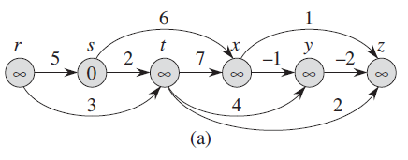
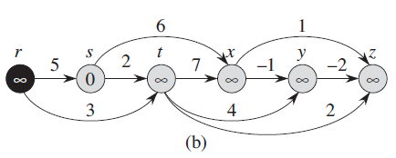
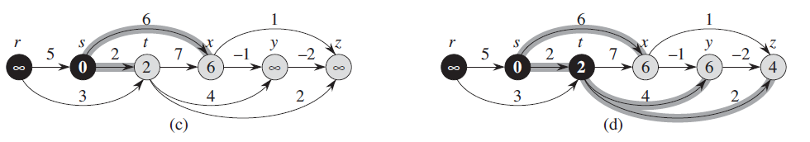
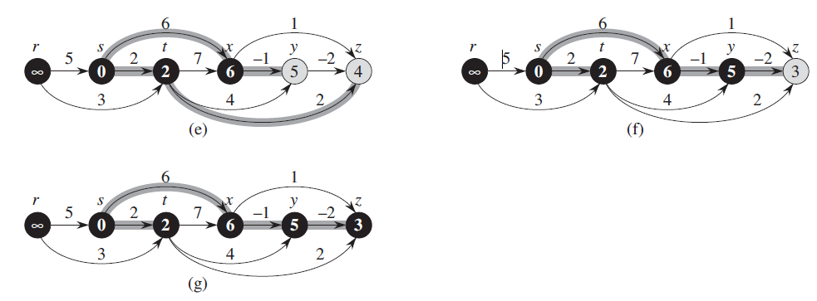

Slide 38
Readings
Chapter 24
Exercise
24.1-6 – Find negative cycle
24.2-4 – Total Number of paths in a DAG
Difficult Problems (Solve these if you want):
24.3-6 modify dijkstra
24-2 – nesting boxes
24-3 - Arbitrage
24.6 – Bitonic Shortest path

